Slide 1
Advanced Web programming
Lec-5
Types, Objects, and Namespaces
(Ref- Beginning of Asp.net 4.5 in C #- Pg no:60……)

Slide 2
Value Types and Reference Types (Pg 60)
C# divides the world of types into value types & reference types. Values types are created on the stack.
All the intrinsic types(int, long) are Value types & thus are created & stored on the stack.
Objects, are Reference types are created on an undifferentiated block of memory known as heap.

Slide 3
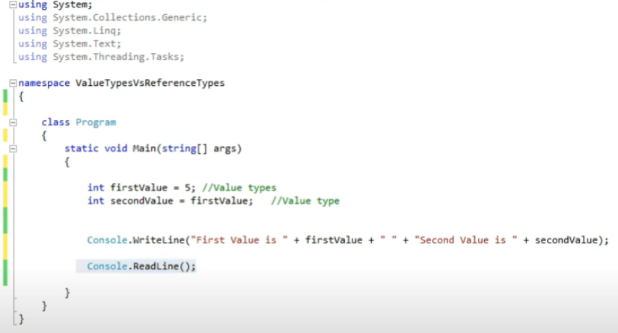
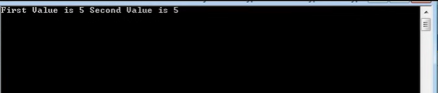

Slide 4
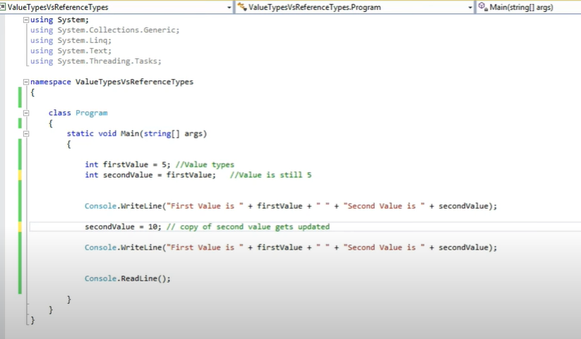
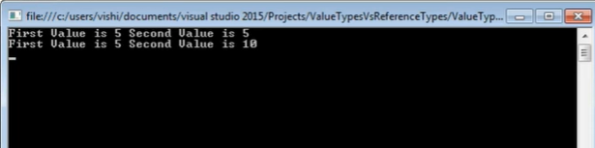

Slide 5
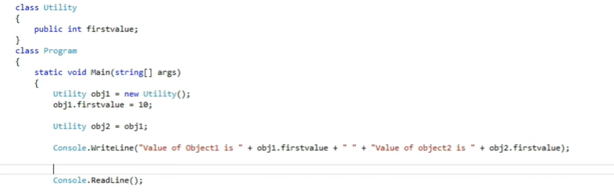
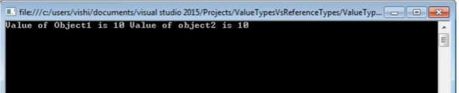

Slide 6
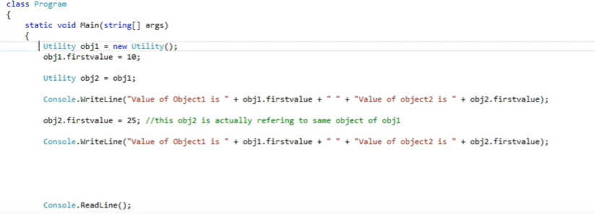
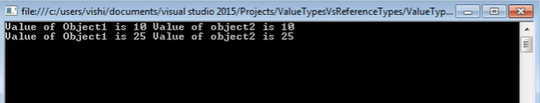

Slide 7
References are actually stored on stack but the object they refer is stored on Heap
When we update a reference type, both the reference will refer to same object.
When we update a value type, it creates a new copy of the variable.
Structs, types such as Int, Float, Long etc. are value Types.
Strings are reference types.
Memory of reference types is claimed by Garbage Collector.

Slide 8
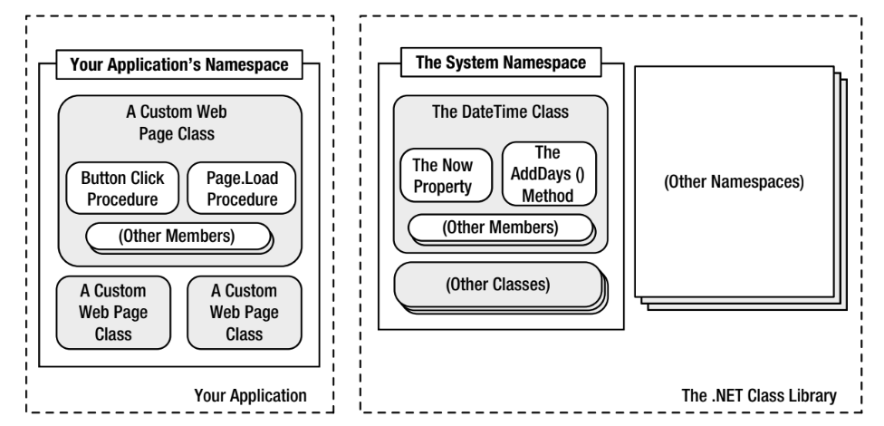
What is namespace?
Below figure shows this arrangement for your own code and the DateTime class. Keep in mind that this is an extreme simplification—the System namespace alone is stocked with several hundred classes.

Slide 9
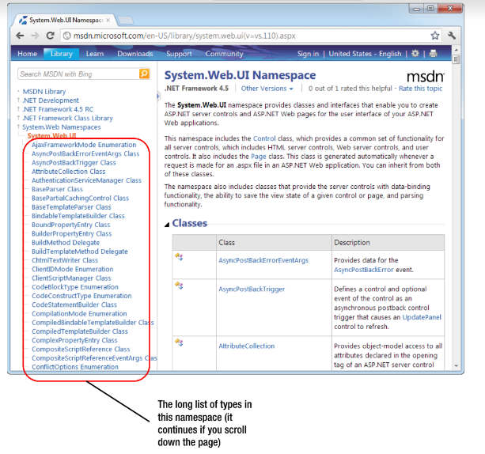
Namespaces can organize all the different types in the class library. Without namespaces, these types would all be grouped into a single long and messy list. This sort of organization is practical for a small set of information, but it would be impractical for the thousands of types included with .NET.

Slide 10
Understanding Namespaces and Assemblies
All .NET classes are contained in assemblies.
You can find the core assemblies for the .NET Framework in the folder C:\Windows\Assembly.
Assemblies are collection of namespaces.
An assembly can contain multiple namespaces. Conversely, more than one assembly file can contain classes in the same namespace. Technically, namespaces are a logical way to group classes. Assemblies, however, are a physical package for distributing code.
An Assembly can be a DLL or exe depending upon the project that we choose.
Dot NET assemblies may or may not be executable, i.e., they might exist as the executable (.exe) file or dynamic link library (DLL) file.

Slide 11
.exe file are self executable files.
DLL file are Dynamic files, they can be reused in other applications.
When compiling an application, you need to tell the language compiler what assemblies the application uses. By default, a wide range of .NET assemblies are automatically made available to ASP.NET applications.
If you need to use additional assemblies, you need to define them in a configuration file for your website.
Visual Studio makes this process seamless, letting you add assembly references to the configuration file by using the Website ➤ Add Reference command.

Slide 12
Private Assembly - Private assembly requires us to copy separately in all application folders where we want to use that assembly’s functionalities; without copying, we cannot access the private assembly features and power.
2. Public Assembly- Public assembly is not required to copy separately into all application folders. Public assembly is also called Shared Assembly. Only one copy is required in system level, there is no need to copy the assembly into the application folder.
3. Satellite Assembly- Satellite assemblies are used for deploying language and culture-specific resources for an application.

Slide 13
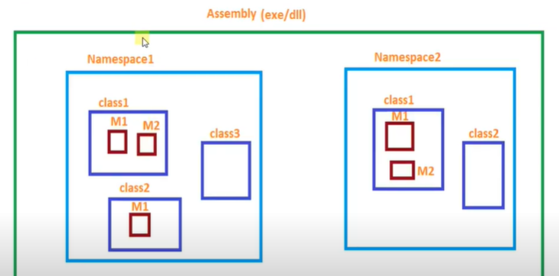
Namespaces

Slide 14
This namespace scope lets you organize code.
They also provide assistance in avoiding name clashes.
Even if you do not explicitly declare one, a default namespace is created. This unnamed namespace, sometimes called the global namespace, is present in every file.
Any identifier in the global namespace is available for use in a named namespace.
https://www.youtube.com/watch?v=IQTbvVemMAg

Slide 15
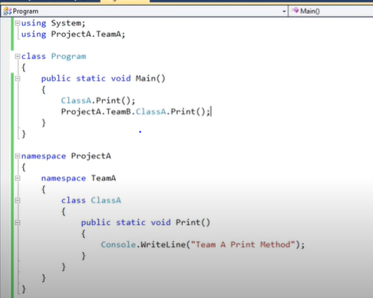


Slide 16
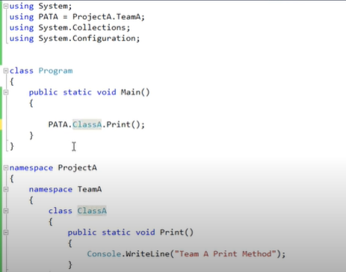
Namespaces alias directives.

Slide 17
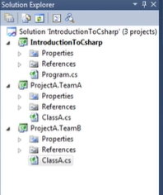
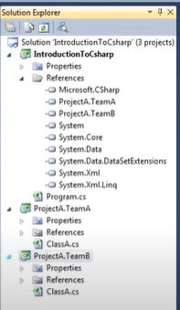

Slide 18
Namespaces alias directives- Sometimes you may encounter a long namespace & wish to have it shorter. This could improve readability & still avoid name clashes with similarly named methods.
.cs (C# file) code is compiled into assembly, found in Bin directory 🡪 Debug folder(we have assemblies in .exe format consisting of the namespaces of our code)
Namespaces don’t correspond to file, directory or assembly names. They could be written in separate files and/or separate assemblies and still belong to the same namespace.

Slide 19
To be continued….

Slide 20
Lec 8 quiz
https://forms.gle/iZHryiw2bzStB1tj8

